Slide 1

Spatial and storm-time dependence of electron microburst pitch angle isotropy
Presented by Conrad Meyer-Reed

Slide 2
Outline:
Introduction
Mission Background
Statistical Year Study
Storm-time Epoch Analysis
Conclusions

Slide 3
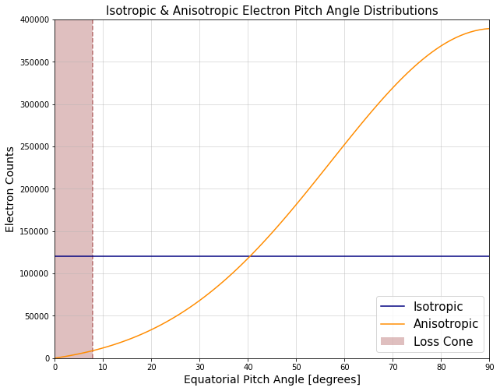
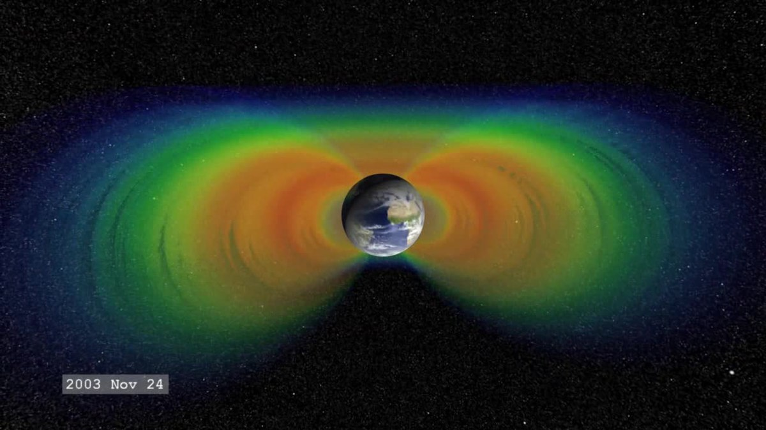
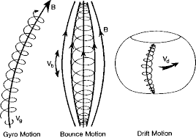
Introduction
The Earth’s radiation belts are composed of electrons interacting with the planetary magnetic field in 3 main motions:
Gyro motion (~1 ms)
Bounce motion (~0.1-1.0 s)
Drift motion (~1-10 min)
Electrons with small velocity pitch angles will more likely precipitate into the atmosphere before bouncing
Pitch angle isotropy is defined by how electron population velocity pitch angles are distributed:
Isotropic: Pitch angles are pointed everywhere equally
Anisotropic: Pitch angles are pointed unevenly
J. Sample, PhD Thesis (2013)
(From Yuting Ng, 2013)
(From Wikipedia)

Slide 4
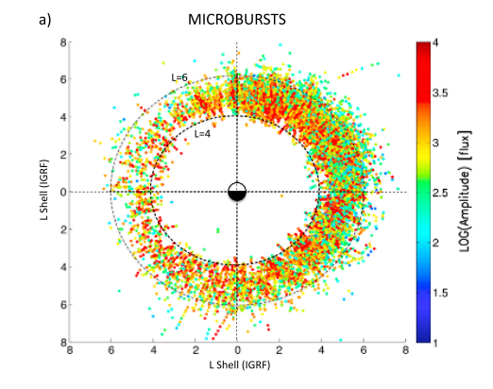
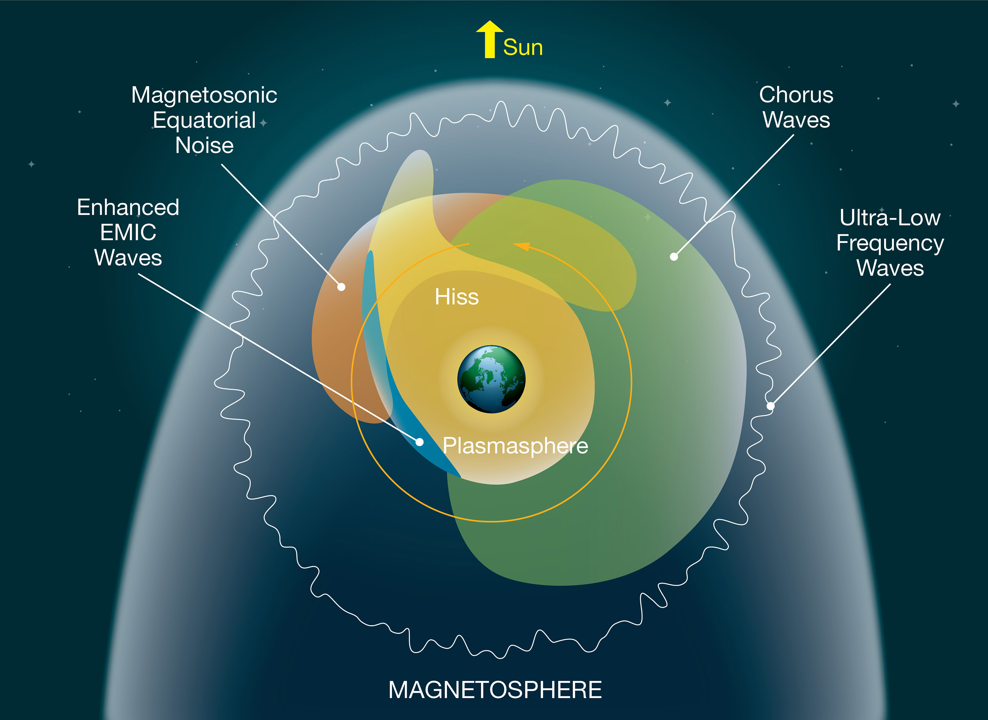
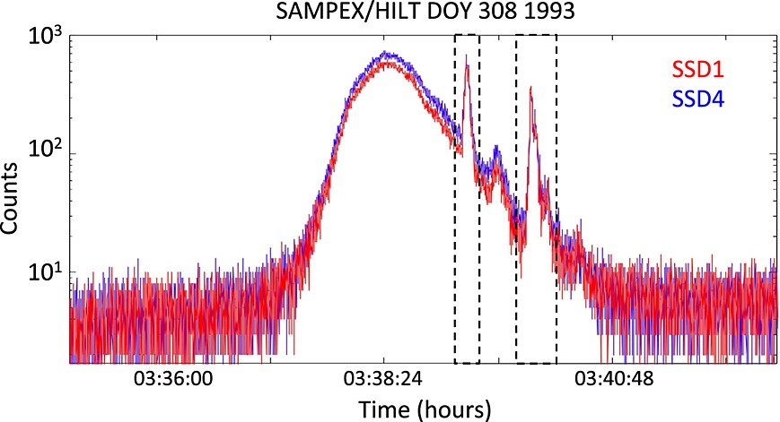
Introduction
(From Blum et al, 2015)
(From Blum et al, 2015)
(From NASA)

Slide 5
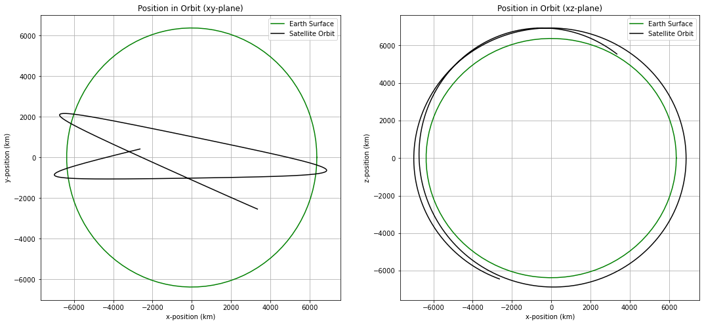
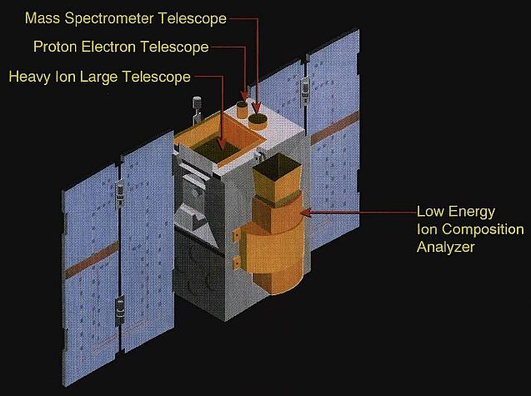
Mission Background
The Solar Anomalous and Magnetospheric Particle Explorer (SAMPEX) satellite collected information about particles in the Earth’s radiation belts in near polar orbit from 1992-2004
The Heavy Ion Large Telescope (HILT) instrument onboard the SAMPEX satellite consisted of 4x4 Silicon detector array that recorded >1 MeV electron counts in high latitude regions of the magnetosphere
(From eoPortal Directory)

Slide 6
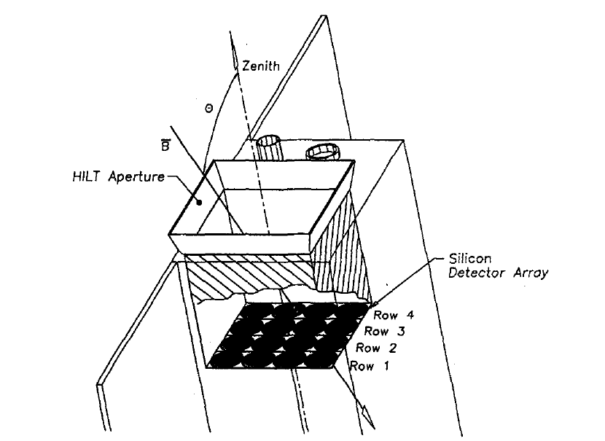
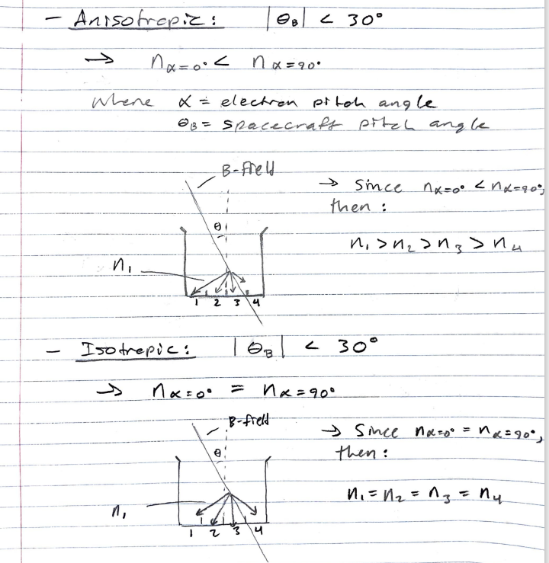
Mission Background
When anisotropic populations of electrons are collected by the HILT instrument, the geometry of the detector rows will cause differences in the total electron counts detected across the array.
Conversely when isotropic populations of electrons are collected by the HILT instrument, the total electron counts detected will be similar across the array.
(From Blake et al, 1996)
By taking the ratio of electron counts from Row 1 (SSD1) and Row 4 (SSD4) of the detectors, a measure of pitch angle isotropy can be determined, where:
Iso = 0 -> Anisotropic
Iso = 1 -> Isotropic

Slide 7
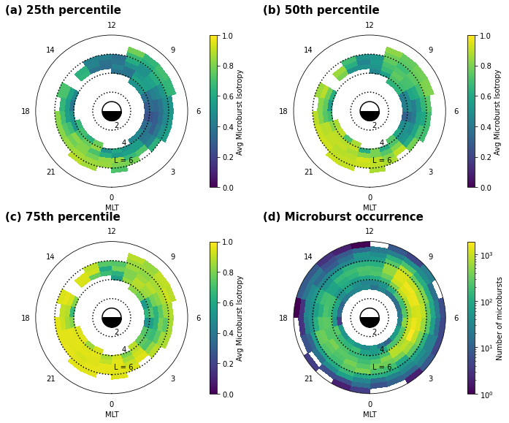
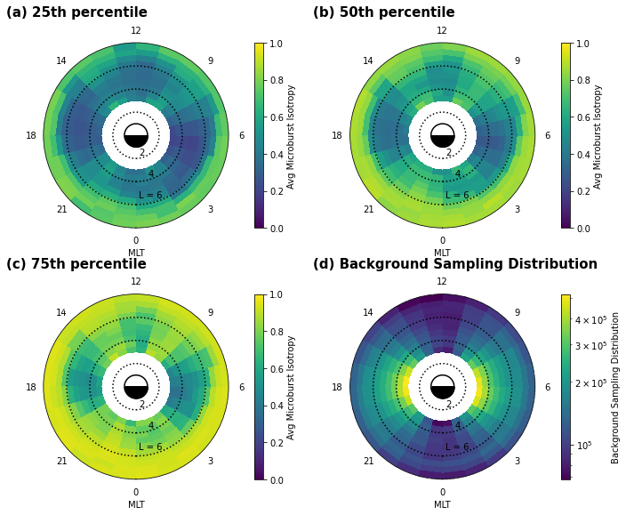
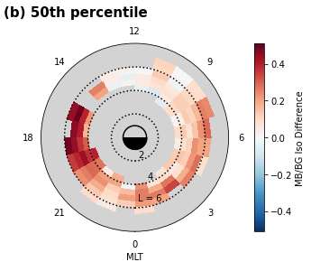
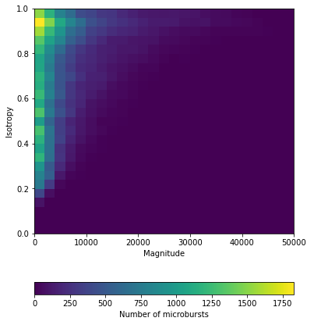
Statistical Year Study
Results:

Slide 8
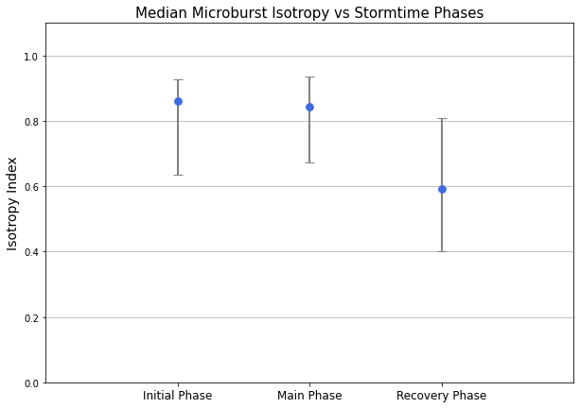
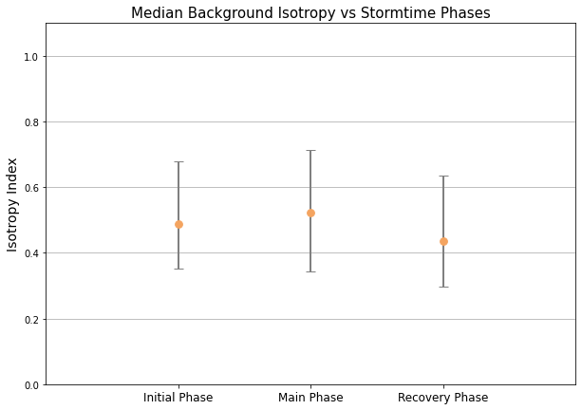
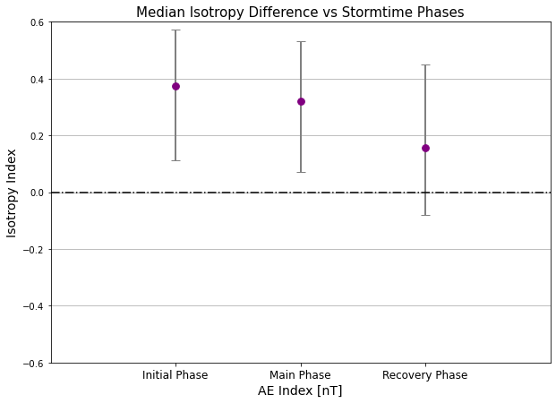
Storm-time Epoch Analysis
Results:

Slide 9
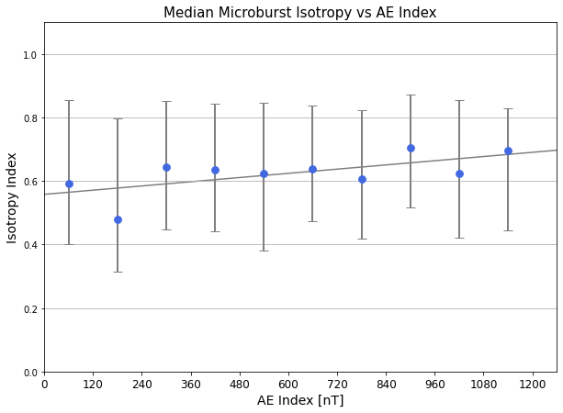
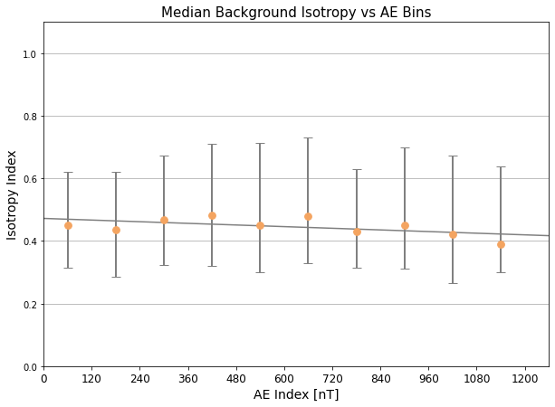
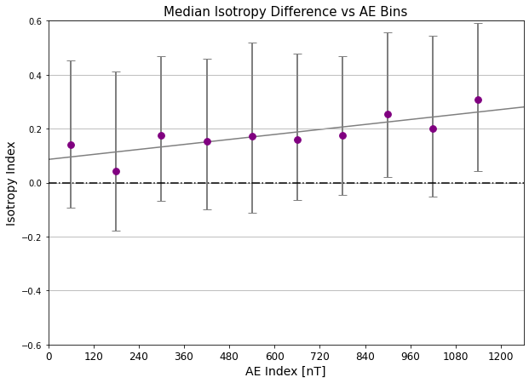
Storm-time Epoch Analysis
Results:

Slide 10
Conclusions

Slide 11
Acknowledgements

Slide 12
Extra Info Slide

